Slide 1
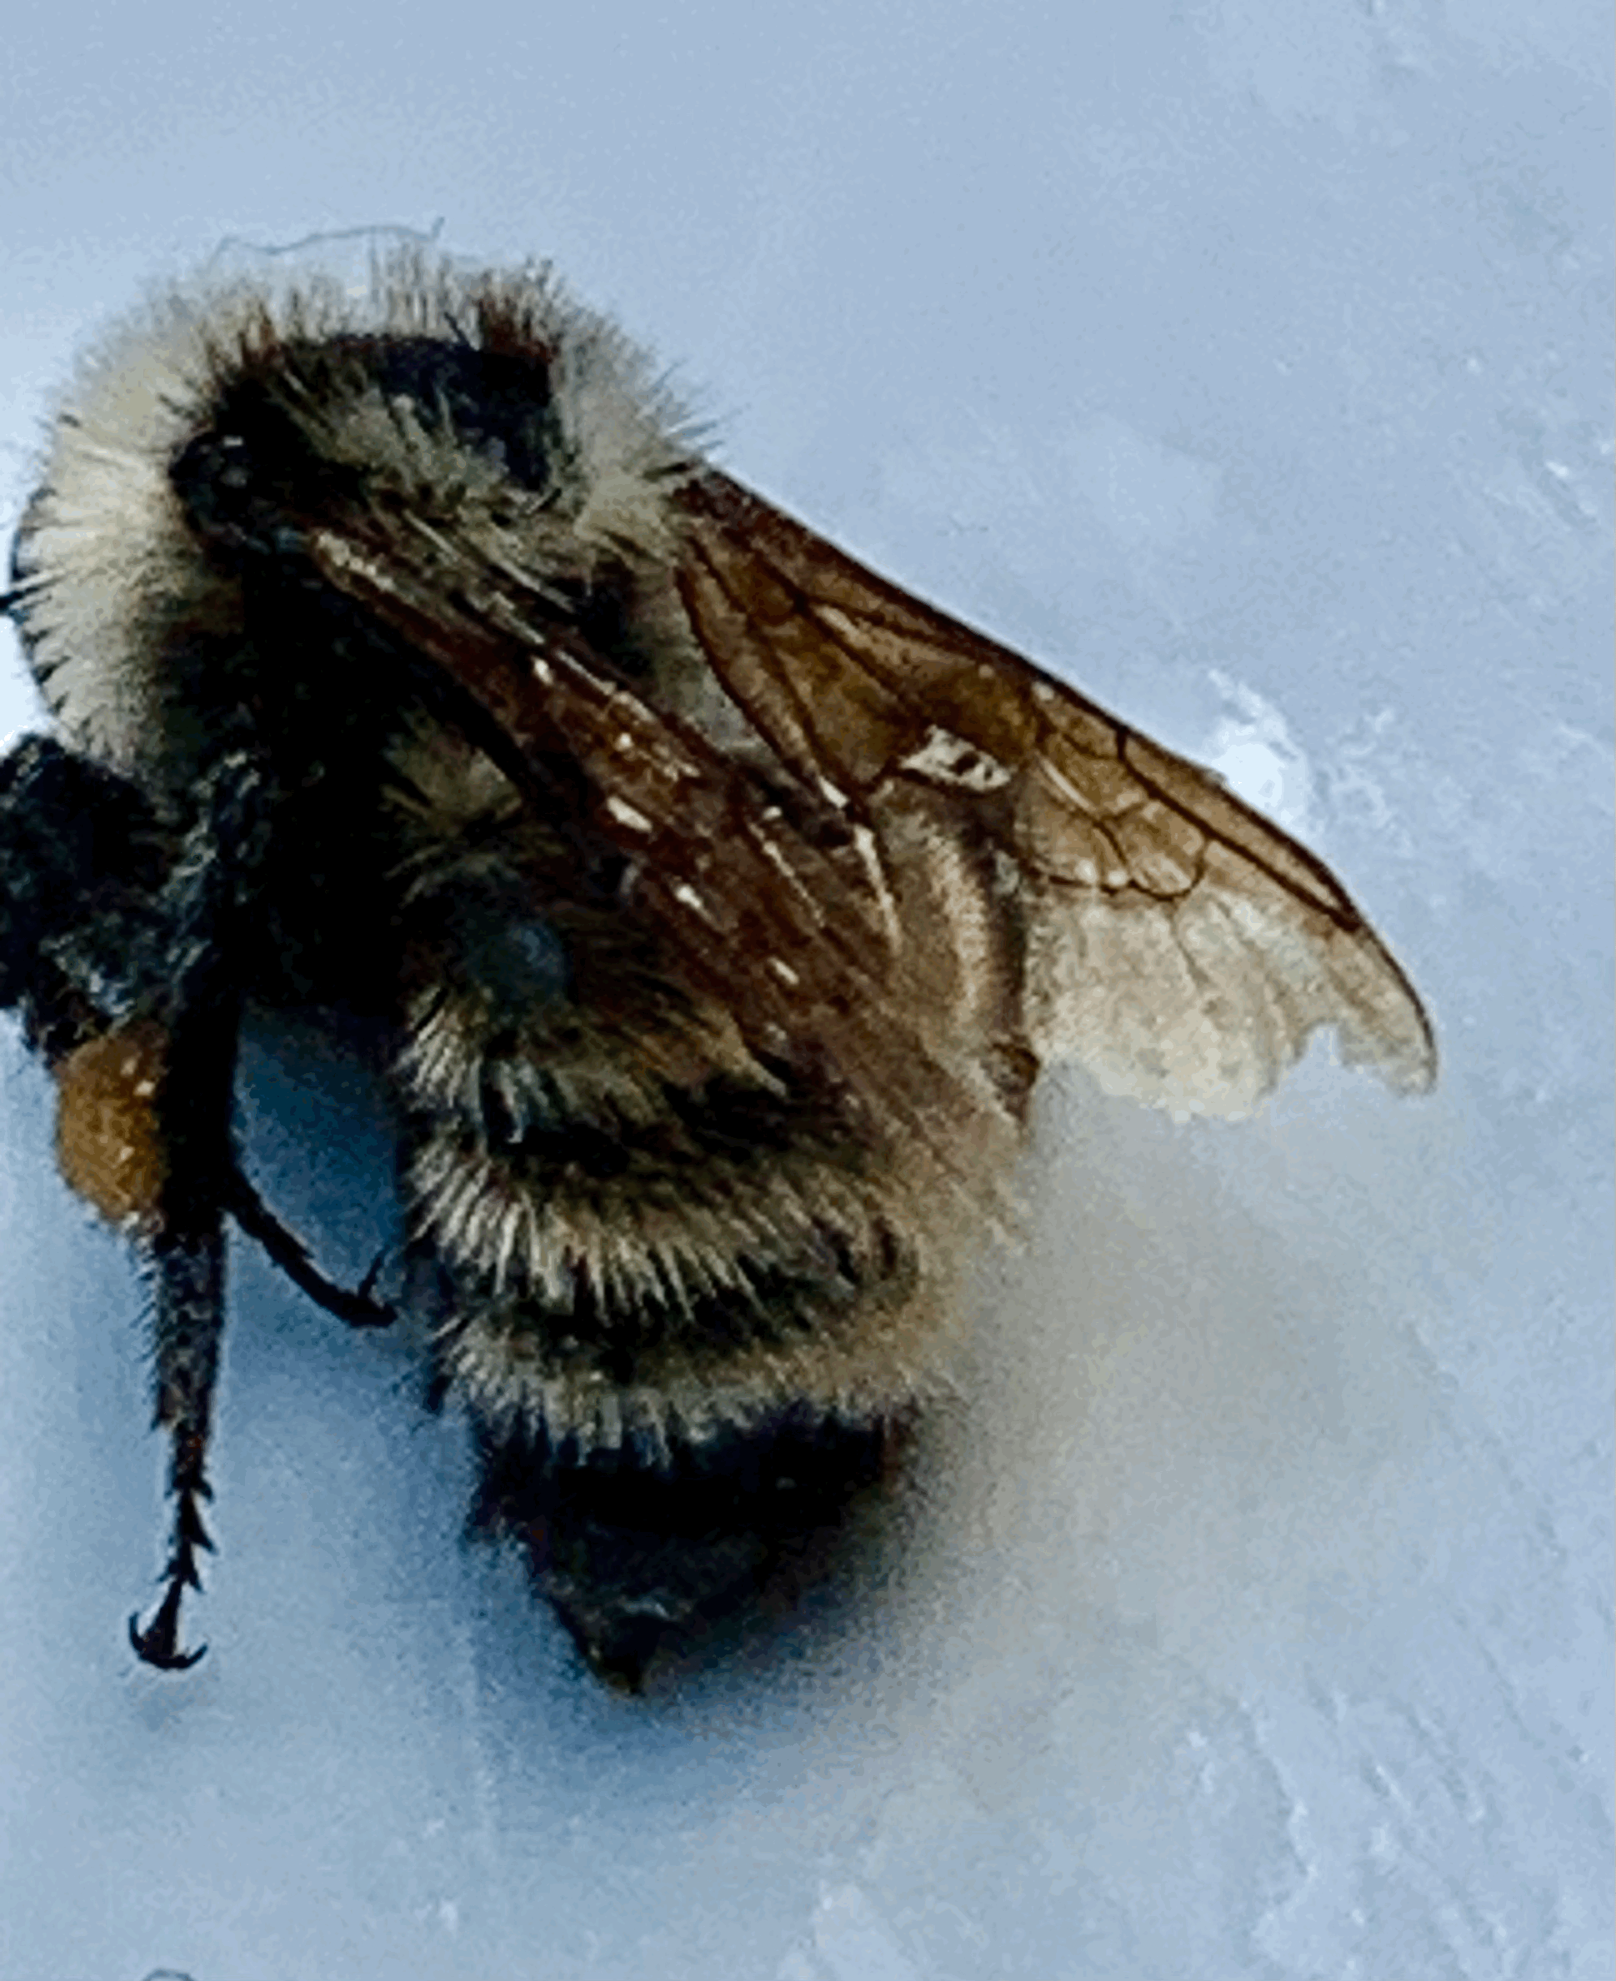
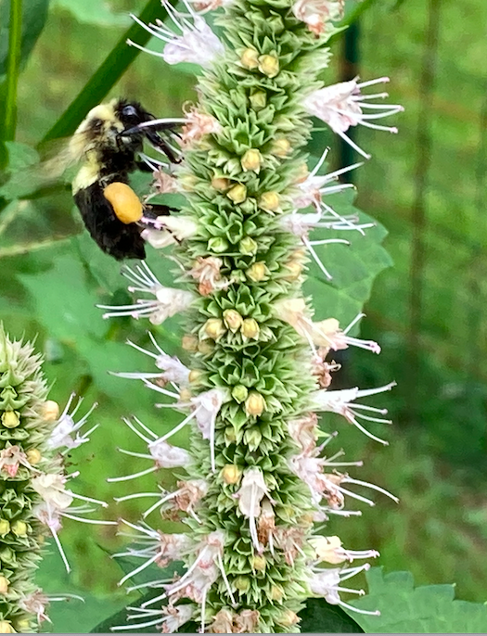
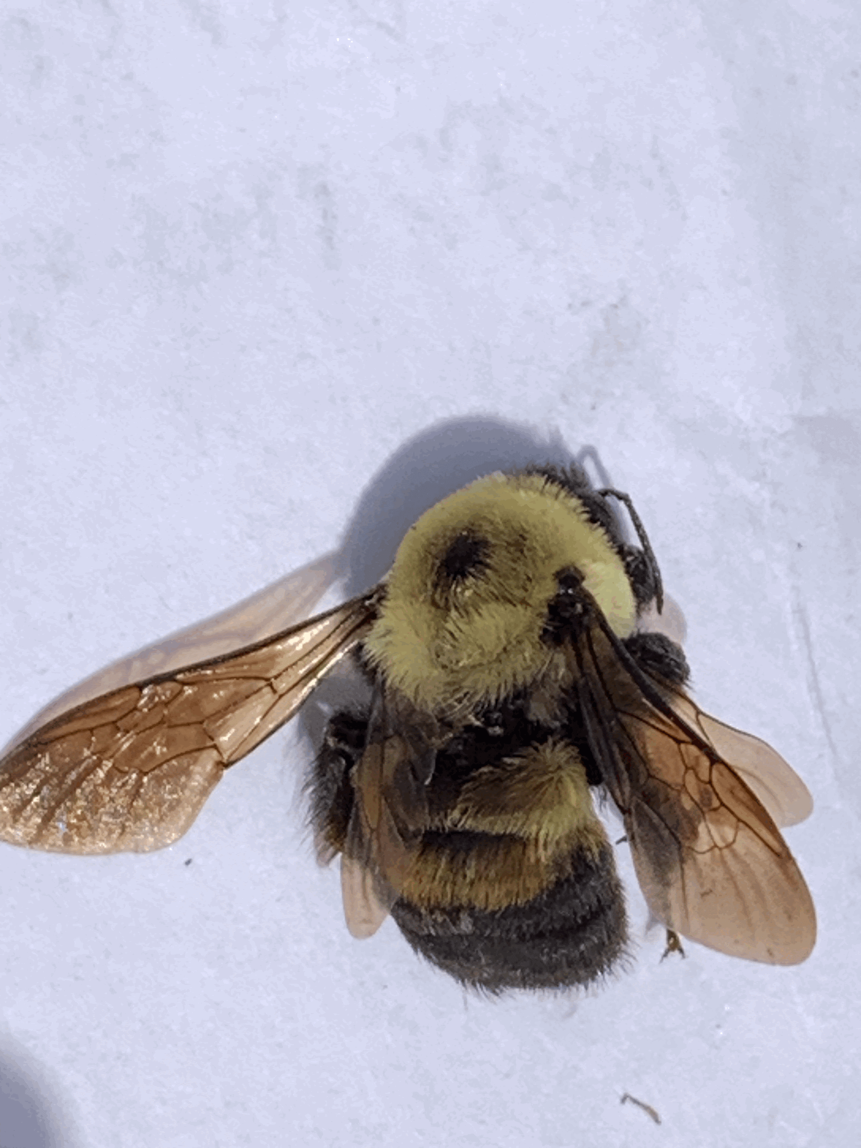
“Build It and They Will Come” ….
Thanksgiving Forest Pollinator Garden: A “Garden for a Purpose” Update
September 9, 2025 Conservation Commission
Presenters: Jeff Boutin, Robyn Holman, Karen Walton
Bombus fervidus
Bombus griseocollis
(brown-belted bee)

Slide 2
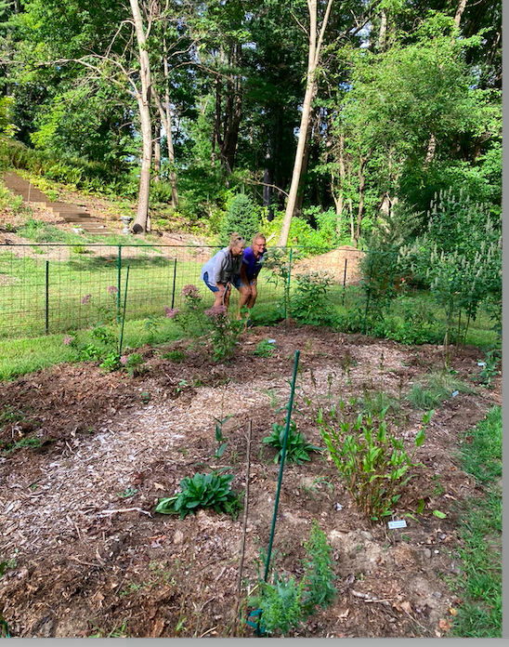
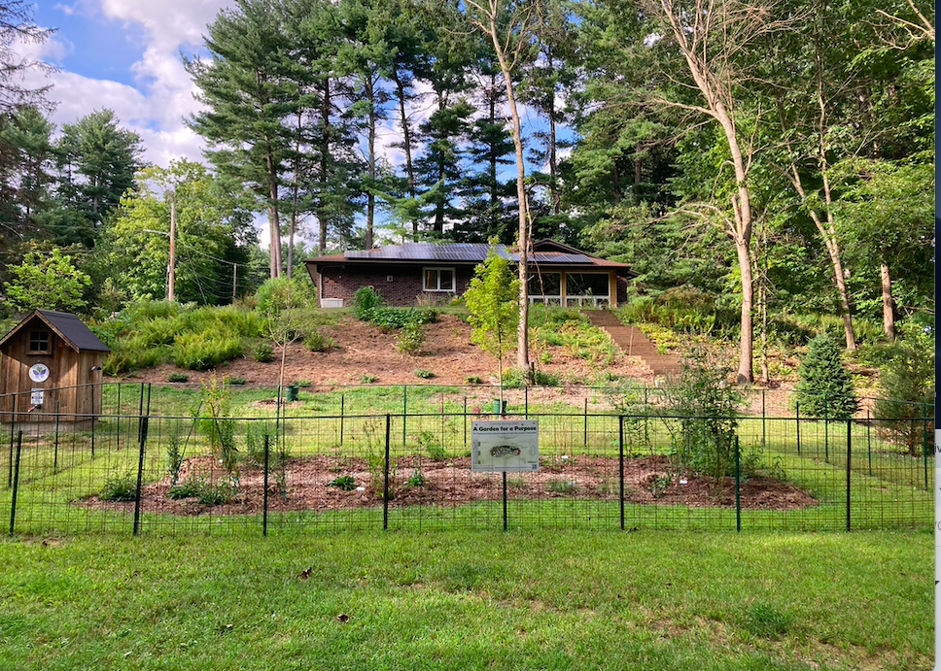
Thriving Trees and Garden

Slide 3

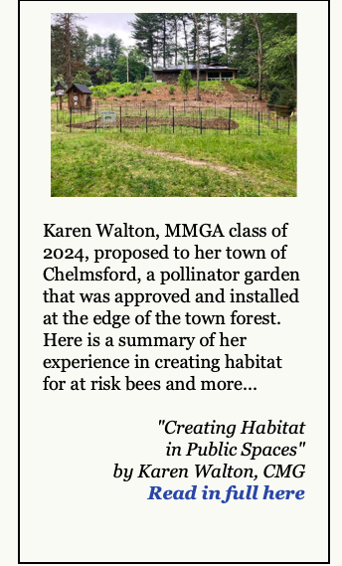

Highlighted in Massachusetts Master Garden Newsletter
Working on developing more
partnerships and press

Slide 4
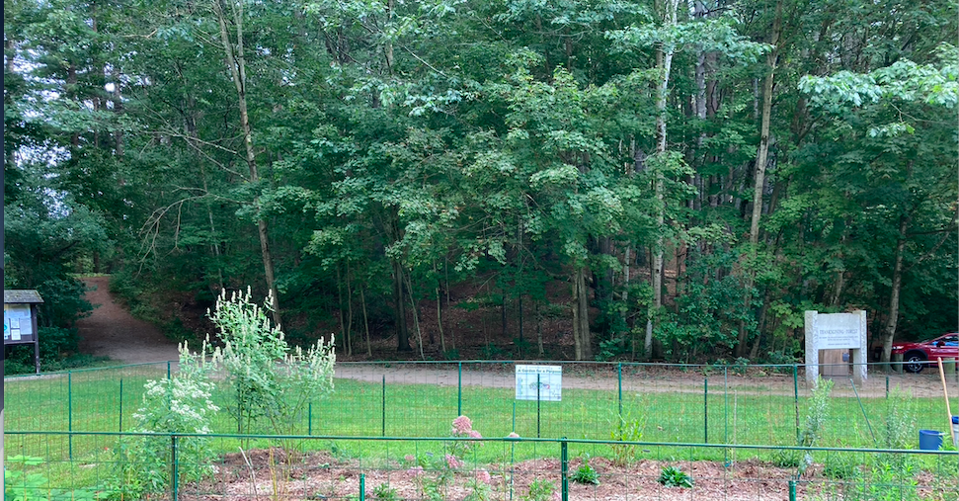
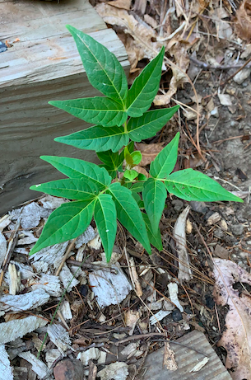
PHASE 2
Clear Norway Maples
Eradicate Invasives

Slide 5
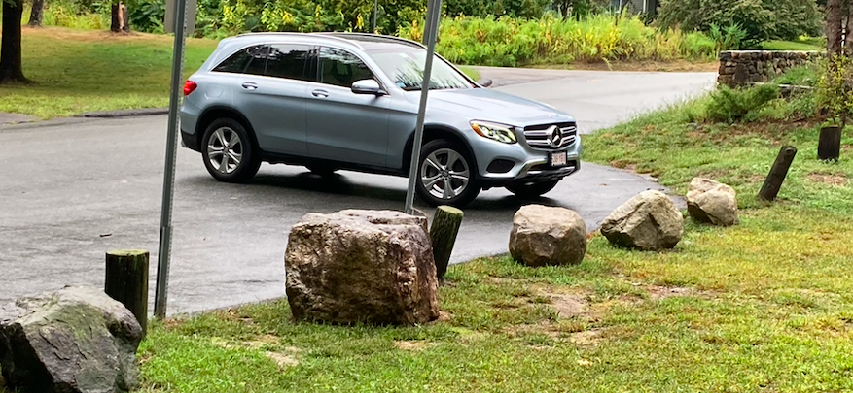
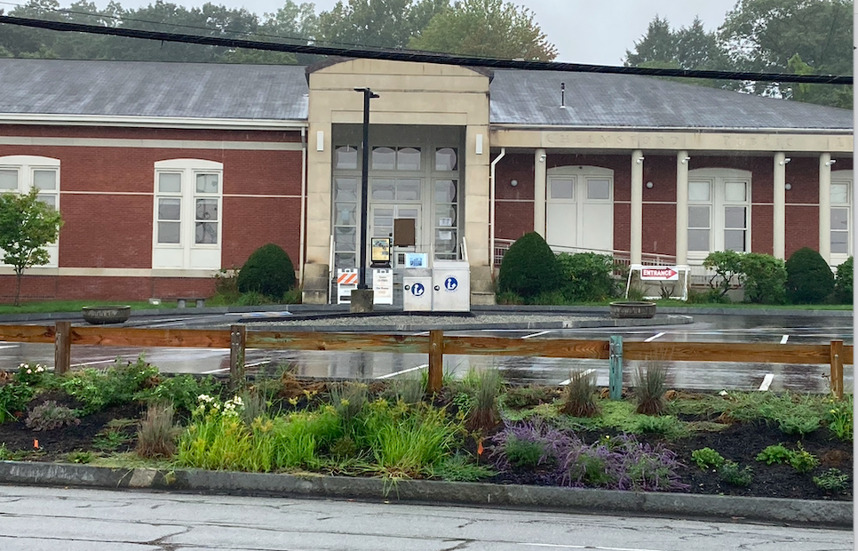
Remove Posts, Relocate Boulders, and Install a Wooden Guardrail

Slide 6
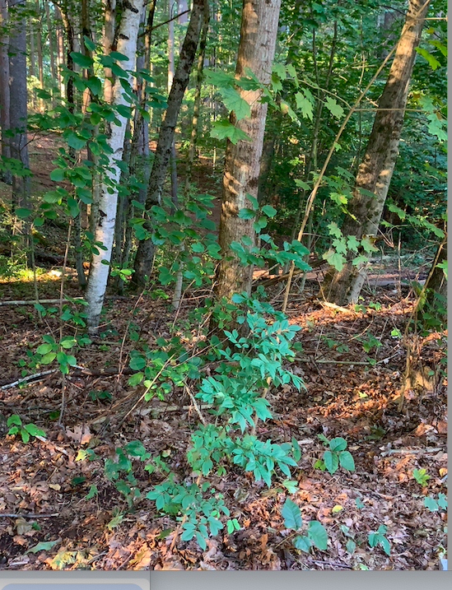
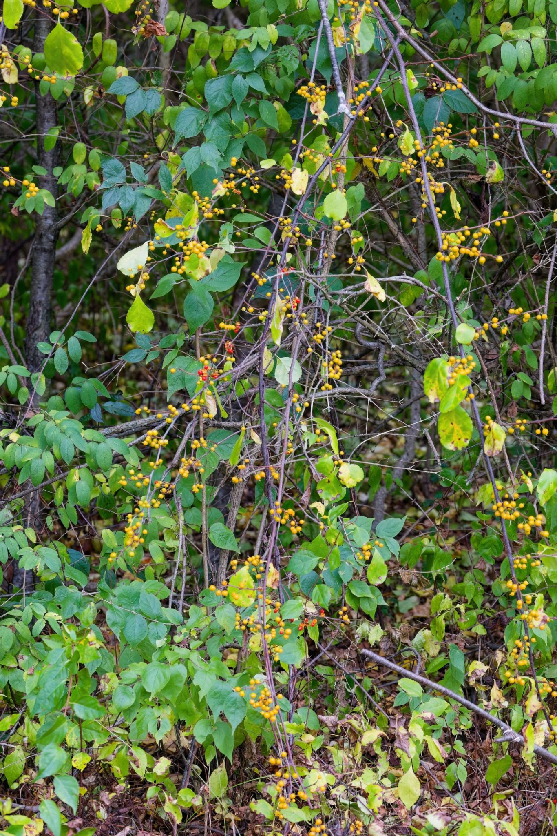
BAD INVASIVES
Norway, Buckthorn,
Burning Bush
Tree of Heaven
Bittersweet

Slide 7
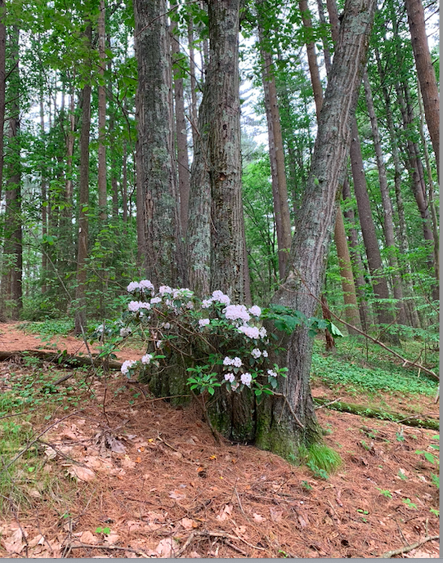
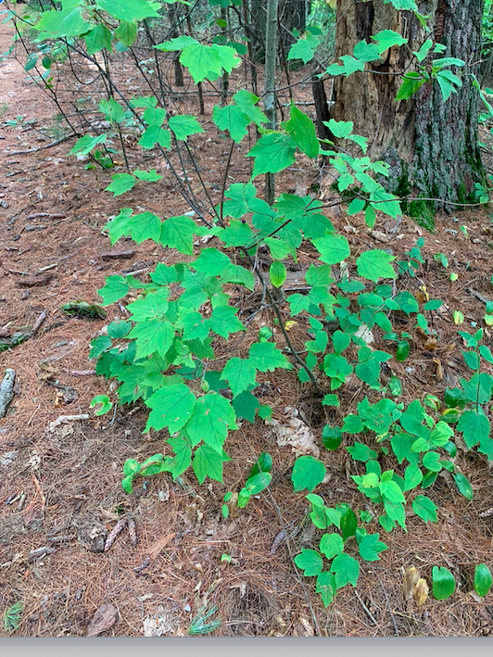
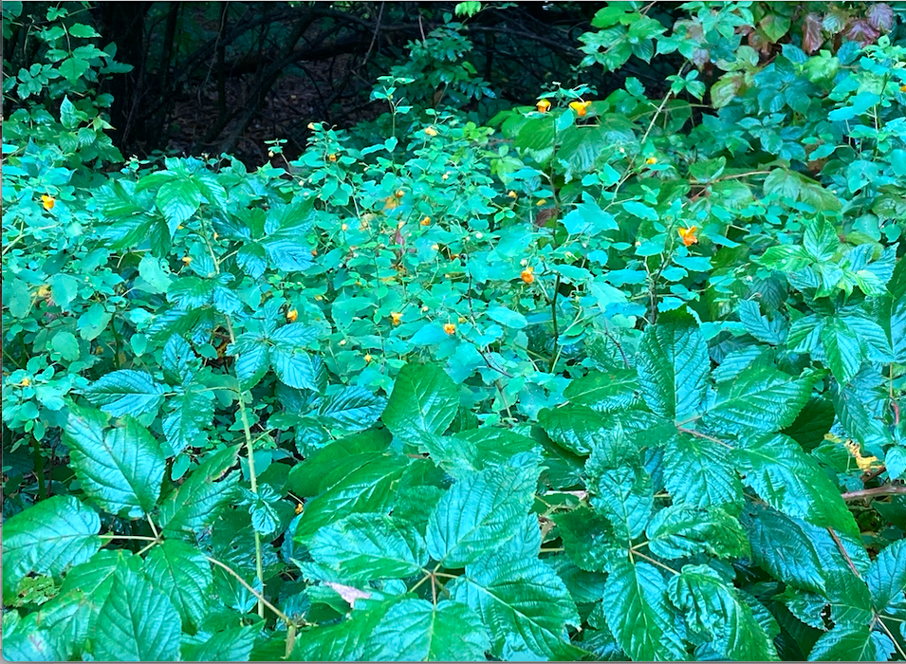
Good Natives Already There That Need To Come Forward and Shine
Jewelweed amongst Buckhorn
Mountain Laurel
Maple Leaf Viburnum

