Slide 1
Article __: Amend the zoning map: rezone existing IA parcels to RM, 13-36-2 & 13-36-4, rezone the following parcel to RC, 13-19-15, 13-19-16, 13-19-17, 13-19-18, 13-19-19, 13-19-21, 13-19-22, 13-19-23, 13-35-1, 14-19-6, 14-19-9, 14-19-13, rezone parcel 14-19-8 to CB and rezone the following parcels from IA, limited Industrial to CBLT, 13-19-20, 13-36-1, 13-36-3, 13-36-5, 13-36-8, 13-36-10, 14-19-1, 14-19-2, 14-19-3, 14-19-4 and 14-19-5.
Chelmsford Planning Board

Slide 2
Middlesex St Zoning Conflict Corrections
Chelmsford Planning Board

Slide 3
What and Why?
A number of the zoning conflicts identified in town
Options to mitigate:
  Overlays
  Change zoning to other current zones
    Changing the map
    Changing the use table for a zone
    Combination of both
  Create new zones
Looking at the conflict areas, using Kate’s Corner as a model - Decided to create new zone
Notes:
Overlays are good for expanding options available to property
But if looking to restrict, changing the zoning is the best option
We did not want to negatively impact the zones in other parts of town where there are not conflicts, so opting to create a new zone specifically designed for this application made the most sense.

Slide 4
What and Why?
Created (CBLT – CB Light)
Solution for at least some of zoning conflicts in town related to IA zones
Use as a transition zone between IA and other zones like residential zones
Lessen the negative impacts to other non-IA zones
Applied to Kate’s Corner –Fall 2025 Town Meeting
Current Proposal - Apply updated zoning to the area on Middlesex ST near The Landing at Chelmsford Mills
Notes:
Can also use it as a replacement for IA in some heavily residential areas but where the area is too small for IA, CBLT, and Residential
While developing this new zoning district, in addition to using Kates Corner as a model, we also used the area on Middlesex St near The Landing at Chelmsford Mills as a stress test to make sure it would work in other areas of town.
Current proposal is taking the work we did in that stress test and finalizing it.

Slide 5
CBLT Summary
New zoning district (CBLT)
Ultra-light Manufacturing defined; Light Manufacturing clarified
Updates to the use table for CBLT (See CBLT Zoning Handout)
  Allows for more commercial uses and fewer industrial uses
All related and required changes to other parts of zoning for new district:
  Dimensional requirements table
  CEIOD dimensional requirements table
  CEIOD applicability
  Property lines landscaping
  Street frontage

Slide 6
Ultra-light Manufacturing
Indoor manufacturing of finished products or components predominately from previously prepared materials, involving specialized and high-value production processes such as precision fabrication, intricate assembly, controlled treatment, packaging, and distribution. All manufacturing operations must occur in fully enclosed, highly controlled environments, producing no detectable noise, odor, smoke, heat, glare, vibration, or other emissions beyond property lines. Operational characteristics generally include limited loading infrastructure and tractor trailer use as compared to more intense manufacturing operations. Examples include, but are not limited to, artisanal food production, clothing and apparel production, prototyping, additive manufacturing (3D printing), manufacturing of precision instruments, medical and dental device manufacturing, electronic component and device manufacturing, boutique furniture making, small-scale pharmaceutical compounding, and small-scale wood and metal fabrication. Excludes heavy industrial activities, processing of raw or unprocessed materials, and outdoor storage.

Slide 7
Light Manufacturing (updated)
Indoor manufacturing of finished products or components predominately from previously prepared materials, involving processes such as fabrication, assembly, treatment, packaging, and distribution. All manufacturing operations must be fully contained within a building, producing no detectable noise, odor, smoke, heat, glare, vibration, or other emissions beyond property lines. Examples include, but are not limited to, food, paper goods, textiles, leather products, plastic items, wood products, metal products, chemical products, and renewable or alternative energy products. Excludes heavy industrial activities, processing of raw or unprocessed materials, and outdoor storage.

Slide 8
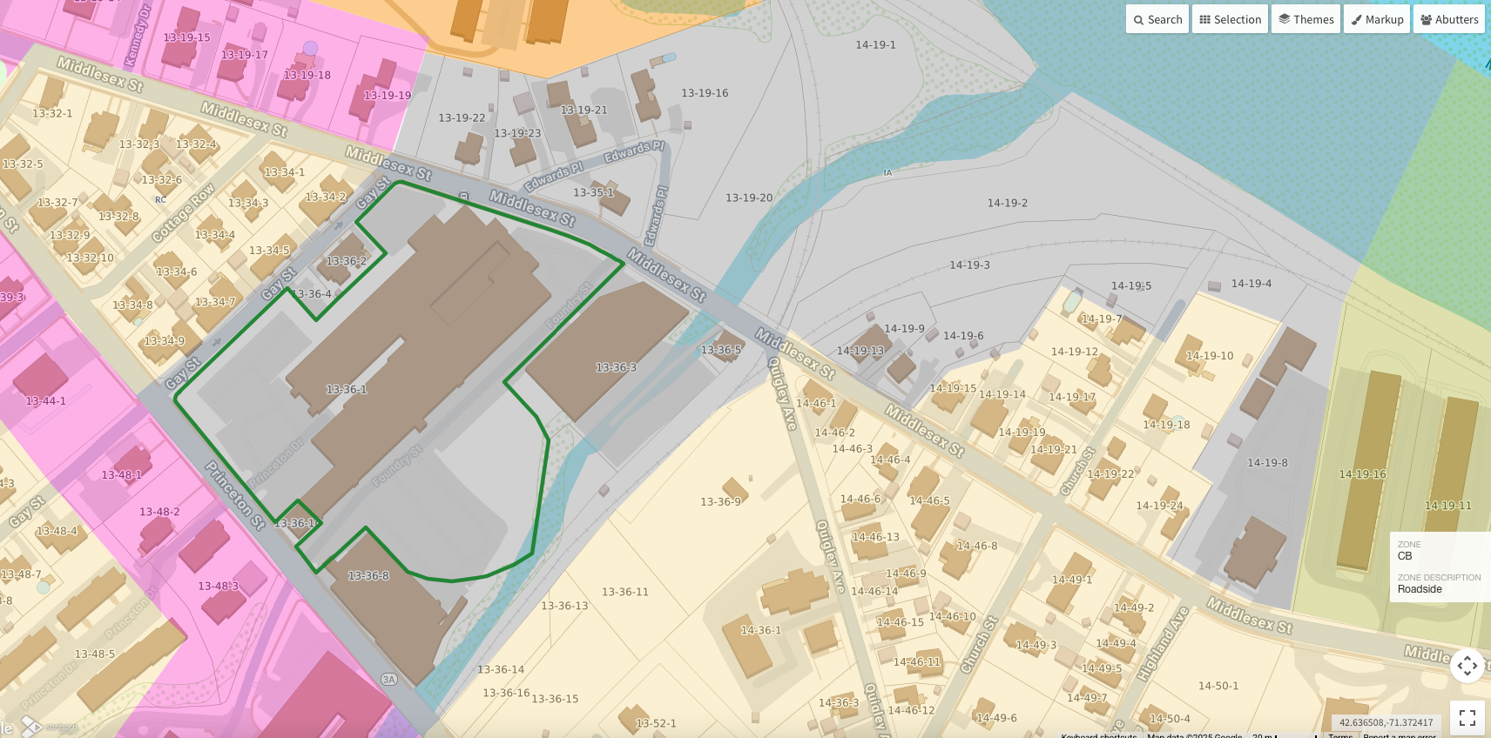
Parcels to Rezone – Current
RM
CD
IA
RC
IA
CB
CD
RC
RC

Slide 9
Parcels to Rezone – Proposed
Remains
CD
RC
Remains
RM
RC
RC
RC
RC
CBLT
RC
RC
RC
CBLT
RC
Remains
RC
CBLT
CBLT
RM
CBLT
CBLT
CBLT
RC
RC
CBLT
CBLT
RC
Remains
RC
Remains
CB
Remains
CD
CB
CBLT
Remains
RC
CBLT

Slide 10
Parcels to Rezone
Rezone to RC
  13-19-15 – currently CD
  13-19-16 – currently IA
  13-19-17 – currently CD
  13-19-18 – currently CD
  13-19-19 – currently CD
  13-19-21 – currently IA
  13-19-22 – currently IA
  13-19-23 – currently IA
  13-35-1 – currently IA
  14-19-6 – currently IA
  14-19-9 – currently IA
  14-19-13 – currently IA
Rezone to RM
  13-36-2 – currently IA
  13-36-4 – currently IA
Rezone to CB
  14-19-8 – currently IA
Rezone to New CBLT
  13-19-20 – currently IA
  13-36-1 – currently IA
  13-36-3 – currently IA
  13-36-5 – currently IA
  13-36-8 – currently IA
  13-36-10 – currently IA
  14-19-1 – currently IA
  14-19-2 – currently IA
  14-19-3 – currently IA
  14-19-4 – currently IA
  14-19-5 – currently IA

